Slide 1
MACHINING SCIENCE AND MACHINE TOOLS
MODULE IV

Slide 2
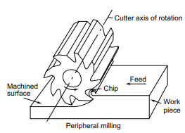
MILLING
the work piece is fed into a rotating milling cutter, which is a multi-point tool
Interrupted cutting: Each of the cutting edges removes material for only part of the rotation of the milling cutter. As a result, the cutting edge has time to cool before it removes material again. Thus the milling operation is much cooler compared to the turning operations seen earlier. This allows for much larger material rates

Slide 3
Machining operation that removes metal as the work is fed against a rotating multi point cutter
Teeth of the cutter removes the metal in the form of chips from the surface of the work to produce desired shape.
Work is held between centers or bolted to machine table
Revolving multi point cutter mounted either on spindle or arbor.
Cutter revolves at high speed and work fed slowly past the cutter.
Work can be fed in a vertical , horizontal or cross direction
As the work advances the cutter ,teeth removes metal from the surface to produce desired shape

Slide 4
Small size of chips: Though the size of the chips is small, in view of the multiple cutting edges in contact, a large amount of material is removed and as a result the component is generally completed in a single pass unlike the turning process which requires a large number of cuts for finishing.
Variation in chip thickness: This contributes to the non-steady state cyclic conditions of varying cutting forces during the contact of the cutting edge with the chip thickness varying from zero to maximum size or vice versa. This cyclic variation of the force can excite any of the natural frequencies of the machine tool system and would be harmful to the tool life and surface finish generated.

Slide 5
Types of Milling Machines
Column and knee type
Hand milling machine
Plain or Horizontal milling machine
Vertical milling machine
Universal milling machine
2. Fixed- bed type milling machine
Simplex;
Duplex;
Triplex
3. Planer type machines
4. Special purpose machines
Rotary table milling machine
Planetary milling machine
Pantograph milling machine
Tracer milling machine
Profile milling machine
Drum milling machine

Slide 6
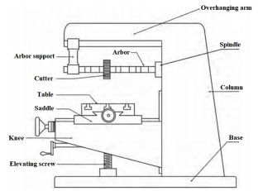
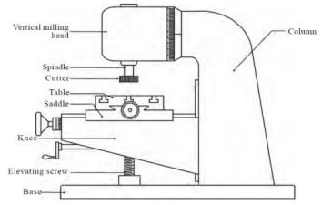
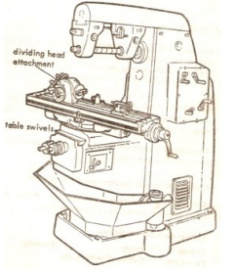
HORIZONTAL MILLING MACHINE
VERTICAL MILLING MACHINE
UNIVERSAL MILLING MACHINE

Slide 7
PARTS OF COLUMN AND KNEE TYPE MILLING MACHINE
BASE
Made of grey cast iron
Act as foundation member
Carries column at one end
Serves as a reservoir for coolants
2. COLUMN
Main supporting frame mounted vertically on the base
Houses all the driving mechanism for spindle and table feed
Front vertical face is provided with guide ways for supporting the knee.
3. KNEE
Portion which projects from column and is made to slide up and down
Position of knee can be adjusted by an elevating screw provided below the knee.

Slide 8
4. SADDLE
• Support and carries the table.
Slides on guide ways provided on the top of the knee
5. TABLE
Table rests on ways on the saddle and travels longitudinally
Acts as a support for the work
T- slots are provided for clamping the work and other fixtures
A lead screw under the table is used to move the table horizontally
In universal machines, table may swiveled horizontally on a circular base.
6. OVERHANGING ARM
Mounted on the top of the column
Serves as a bearing support for the other end of the arbor.

Slide 9
7. SPINDLE
Located in the upper part of the column
Receives power from electric motor through belts and gears
Spindle drive arbor.
8. ARBOR
Extension of spindle on which milling cutters are mounted
Provided with taper shank that fits into machine spindle having taper hole at their nose
Position of arbor can be adjusted with spacers
Draw bolt is used for locking arbor with spindle

Slide 10
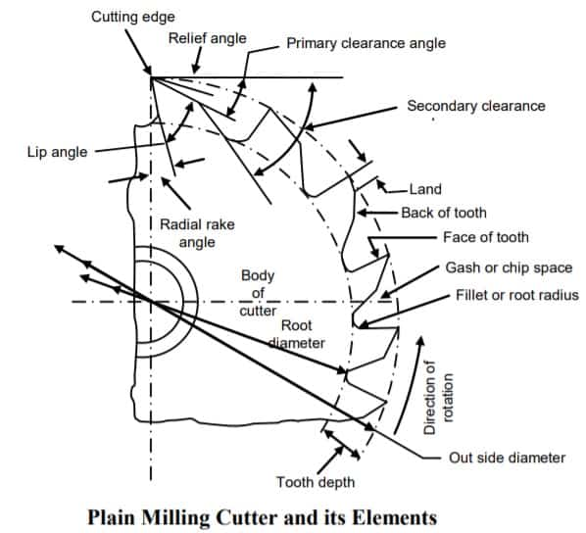
MILLING CUTTER AND ITS ELEMENTS

Slide 11
INDEXING METHODS
INDEXING HEAD OR DIVIDING HEAD
Indexing is the operation of dividing the periphery of a work into any number of equal parts.
Eg: In cutting spur gear, hexagonal and square bolt, splines on shaft equal spacing of teeth on the gear blank is performed by indexing
Indexing is accomplished by using a special attachment known as dividing head or index head

Slide 12
DIVIDING HEAD
Dividing head is one of the most important attachments with the milling machine and it is almost indispensable.
The main spindle of the dividing head drives the work piece by means of a 3-jaw universal chuck or a dog and live centre similar to a lathe
The index plate of a dividing head consists of a number of holes with a crank and pin.
The index crank drives the spindle and the live centre through a worm gear, which generally has 40 teeth
a full rotation of the work piece is produced by 40 full revolutions of the index crank.
Further indexing is made possible by having the index plates with equi-spaced holes around various circles.
This would allow for indexing the periphery of the work piece to any convenient number of divisions.

Slide 13
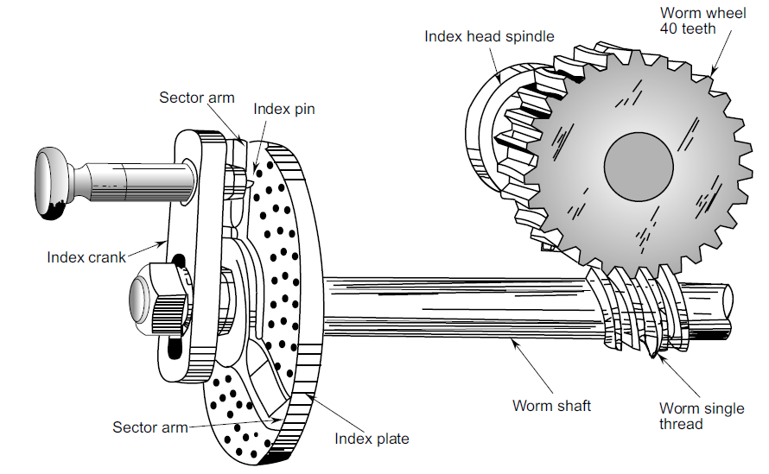
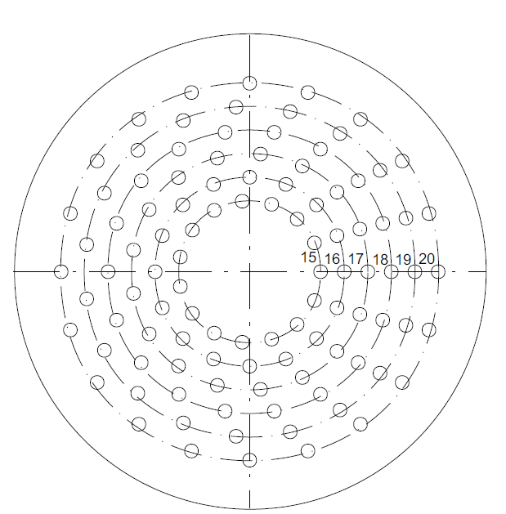
BROWN AND SHARP DIVIDING HEAD

Slide 14
SIMPLE OR PLAIN INDEXING
Universal Dividing Head is used for this
The Indexing plate should be locked with the body
Worm and worm gear is to be engaged
To index the work ,the index crank pin is withdrawn from the hole of the index plate, turn the index crank through calculated number of whole revolutions and holes on one of the hole circles
After required position is reached it is again locked by crank pin
40 turns of indexing crank = 1 revolution of index head spindle
Index plates with concentric circles of holes are used:

Slide 15
Plate: 1 - 15, 16, 17, 18, 19, 20
Plate: 2 - 21, 23, 27, 29, 31, 33
Plate: 3 – 37, 39, 41, 43, 47, 49
Index crank movement = 40/N (N = number of divisions required)
If the index crank movement deducted from above formula is a whole no. then the index crank should be rotated through a complete no. of turns equal to derived whole no.
Suppose it is desired to mill a gear with 8 equally spaced teeth. l/8 th of 40 or 5 turns will produce correct spacing.
i.e. after each milling operation we will rotate the index crank by 5 turns until work is completed.
If index crank movement calculated from above formula is a whole no. and fraction, the numerator and denominator are multiplied by a suitable common no. so that the denominator will turn to a number equal to no. of holes available on any of the index plate

Slide 16
The new numerator now stands for the no. of holes to be moved by the index crank in the selected whole circle in addition to complete turns of index crank
For cutting 16 teeth, 40/16 = 2 turns. i.e. for each indexing we need two complete rotations of the crank plus 8 more holes on the 16 hole circle of plate 1(Plate I - 15, 16, 17, 18, 19, 20 holes)
For cutting 30 teeth, 40/30 = 1 + 1/3 = 1 + 7/21 (One complete turn of indexing crank and 7 holes in 21 hole circle of the index plate 2)

Slide 17
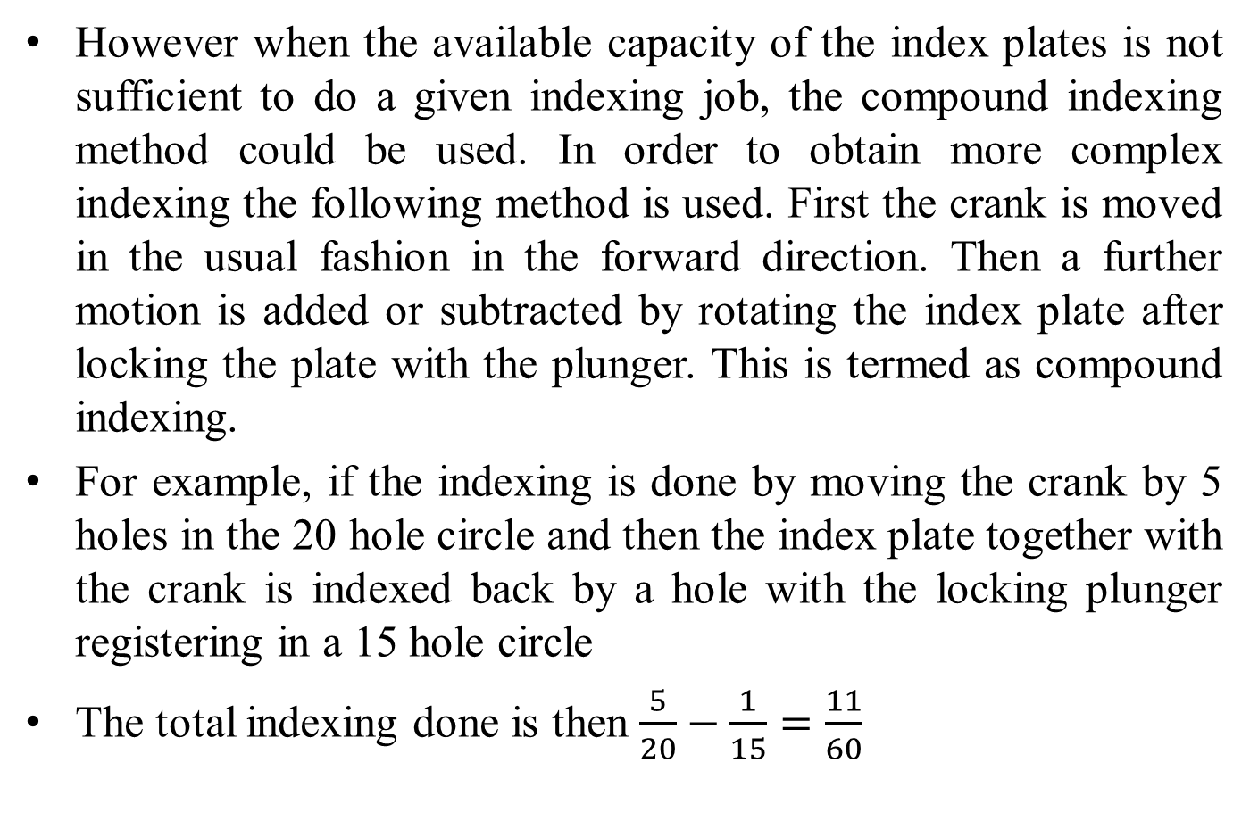
COMPOUND INDEXING
However when the available capacity of the index plates is not sufficient to do a given indexing job, the compound indexing method could be used. In order to obtain more complex indexing the following method is used. First the crank is moved in the usual fashion in the forward direction. Then a further motion is added or subtracted by rotating the index plate after locking the plate with the plunger. This is termed as compound indexing.
For example, if the indexing is done by moving the crank by 5 holes in the 20 hole circle and then the index plate together with the crank is indexed back by a hole with the locking plunger registering in a 15 hole circle
The total indexing done is then $\frac{5}{20}−\frac{1}{15}=\frac{11}{60}$

Slide 18
GRINDING
It is the process of removing metal in small quantities by using abrasive wheel.
It is regarded as a finishing process.
It used for obtaining desired surface finish, accuracy in size and geometrical configuration of the product.
Grinding wheel
It is a multipoint cutting tool.
It is composed of abrasive grains held together with a suitable bond.
Each abrasive grain will act as an individual cutting tool and removes the metals in the form of small chips.

Slide 19
ADVANTAGES OF GRINDING.
The surface finish obtained is superior to that of any other machine tool, and is also one of the most dimensionally accurate machining processes.
Hardened components can be machined by grinding, which would be difficulty or even impossible for other machine tools.
Grinding requires very little pressure permitting its use on light and delicate parts.
DISADVANTAGES OF GRINDING
Work surface gets over heated.
Wheel chatter and vibrations result inaccuracies, and duplicate pieces do not have the same dimensions.
Grinding is not suitable as a machining process where high metal removal is required.

Slide 20
ABRASIVES
It is a small non-metallic hard particle having sharp edges and an irregular shape.
They are capable of removing small amount of materials from the surface in the form of small chips.
Characteristics of abrasives
Must be harder than material being grind.
Must be strong enough to withstand grinding pressure.
Must be heat resistant.
Must be capable to break when the cutting edge is dull.

Slide 21
Types of Abrasives
1. Natural abrasives
These are obtained from earth’s crust which includes sand stone, emery, corundum & diamond.
Sand stone is relatively soft and can’t be used for grinding harder materials.
Emery & corundum are natural aluminum oxides, and have a greater hardness and better abrasive action than quartz.
Diamond is one of the best natural abrasive but due to high cost its use is limited to grinding cemented carbides, glass, marbles & garnets.
Due to lack of uniformity and contain a high percentage of impurities. They have been almost totally replaced by artificial abrasives.
2. Artificial abrasives
It is used extensively because their characteristics can be easily controlled
Aluminium Oxide (Al2O3)
This is one of the natural abrasives found called corundum and emery. However the natural abrasives generally have impurities and as a result their performance is inconsistent.
Hence the abrasive used in grinding wheels is generally manufactured from the aluminium ore, bauxite.
b) Silicon Carbide (SiC)
Silicon carbide is made from silica, sand, and coke with small amounts of common salt.

Slide 22
c) Cubic Boron Nitride (CBN)
Cubic Boron Nitride (CBN) next in hardness only to diamond
It is not a natural material but produced in the laboratory using a high temperature/ high pressure process similar to the making of artificial diamond.
CBN is less reactive with materials like hardened steels, hard chill cast iron, and nickel base and cobalt based super alloys.
CBN grains have 55 times higher thermal conductivity, four times higher the abrasive resistance and twice the hardness of the aluminum oxide abrasives.
They can retain their strength above 10,000°C. CBN is very expensive, 10 to 20 times that of the conventional abrasive such as aluminium oxide.
d) Diamond
Diamond is the hardest known material that can be used as a cutting tool material.
It has very high chemical resistance along with low coefficient of thermal expansion.
Also it is inert towards iron.

Slide 23
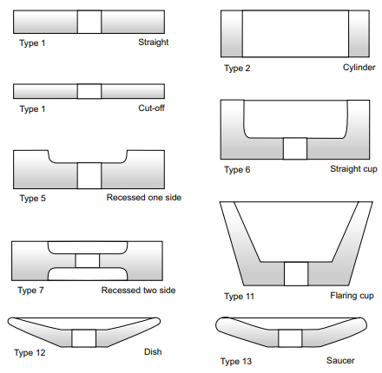
Grinding wheel types

Slide 24
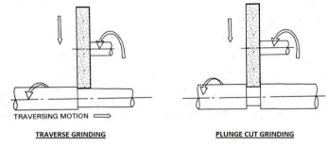
Types of grinding machines
Centre type cylindrical grinders
In which work is mounted between centers & rotated against the wheel.
The work must pass through wheel or Vic versa.
Transverse grinding
Plunge cut grinding
Transverse grinding
Work reciprocates as the wheel feeds into the work
This operation produce cylindrical shapes longer than the width of the wheel
Plunge cut grinding
Work rotates in fixed position and the wheel is fed into the work until the required dia.
The length of cylindrical shape produced is equal to the width of the wheel

Slide 25
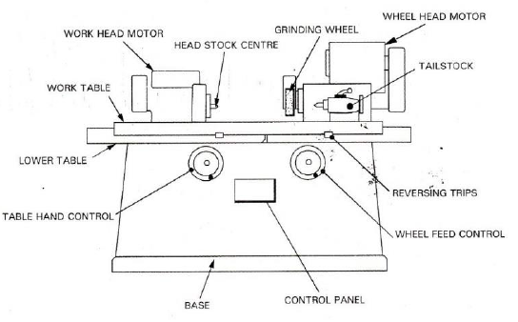
CYLINDRICAL GRINDING
The plain cylindrical grinding machine has the following parts,
1. Bed or Base
2. Table
3. Headstock
4. Tailstock or Foot stock
5. Wheel head

Slide 26
In cylindrical grinders the work is mounted between the centers and rotated against the grinding wheel.
The work may also be held in a chuck for certain operations.
The various movements involved in a cylindrical grinding are given below,
1. The work must revolve.
2. The wheel must revolve.
3. The work must pass the wheel or the wheel must pass the work.
4. The movement of wheel into the work or work into the wheel.

Slide 27
Base:
The base or bed rests on the floor. The top of the base is machined accurately to form ways for the table. It also houses the table drive mechanism.
Table:
The lower table mounted on the ways of the bed. It provides traverse motion to the work past the grinding wheel. It can be operated manualy.
Upper table:
It is mounted on lower table and can be swivelled for grinding tapers and alignment purposes. The head stock and tail stock are mounted on this table.
Head stock:
Head stock supports and drive the work piece with the help of centre and dog or chuck

Slide 28
Tailstock:
Tailstock or foot stock is mounted on the right end of the table. It can be adjusted along the length of the bed to support the right end of the work.
Wheel head:
Wheel head is mounted on a cross-slide at right angle to the table, providing the in-feed movement of the wheel to the work.

Slide 29
CENTRELESS GRINDING
In which the work is supported by a combination of a work rest blades
Two wheels are used ,one is grinding wheel and other is regulating wheel
Its performed on work which does not have centers
It reduces the total operation time by eliminating need for center holes in the work piece
The grinding wheel rotates at higher speed than the regulating wheel.
Regulating wheel control the rotation of work piece

Slide 30
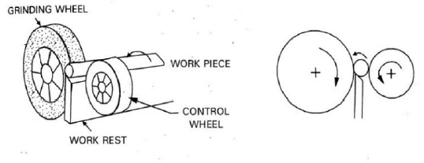
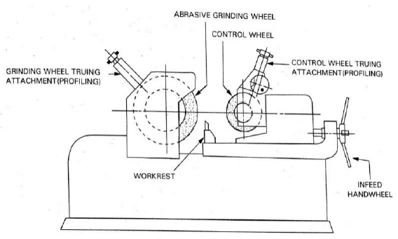

Slide 31
JIGS AND FIXTURES
JIG: it is a work holding device also locater or guides the cutting tool with respect to the work piece
FIXTURE: it is a work holding device but does not locates or guides the cutting tool

Slide 32
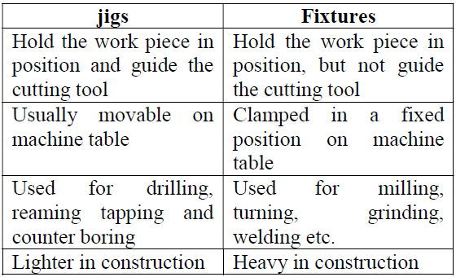
DIFFERENCE BETWEEN JIGS AND FIXTURES

Slide 33
ADVANTAGES OF JIGS AND FIXTURES
Reduce the operation time, and increases productivity
Facilitates uniform quality and ensures inter changeability of component
Unskilled operators can do the job, thus saving in labour cost
Ensures higher accuracy and surface quality
Reduce the overall cost of product

Slide 34
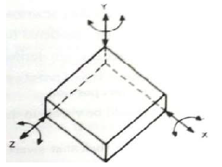
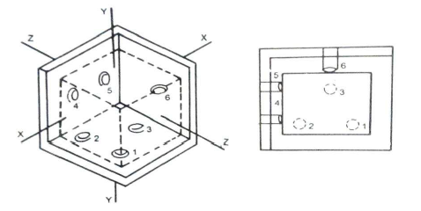
PRINCIPLES OF LOCATION
An object in space has 6 digress of freedom.3 linear movements along x, y and z axes and 3 rotations about these 3 axes.
Locating means preventing the degrees of freedom of the work piece when it is placed in the jig or fixture. It can be done by providing pins at correct positions as follows
Pins 1,2,3:-prevent linear motion along y and rotation about z and x
Pins 4,5:-Prevent linear motion along z and rotation about y
Pin 6:-Prevent linear motion along x

Slide 35
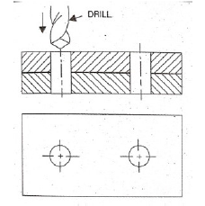
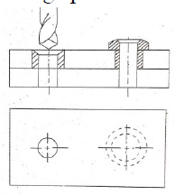
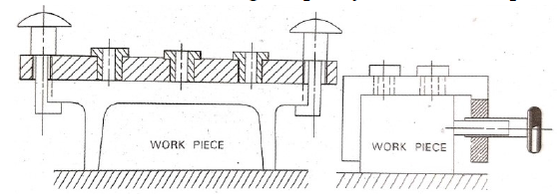
TYPES OF DRILL JIGS
1. Template jig
Used when making holes
Contains holes to guide the tool and is used directly over the component
2. Plate jig
Template jigs in which drill buses are provided is called plate jig, used for accurate drilling on large parts
3. Channel jig
It is in the form of standard channel
Component is located in a channel and is clamped by screw
Used for drilling simple symmetrical shapes

Slide 36
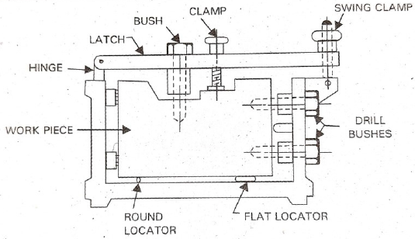
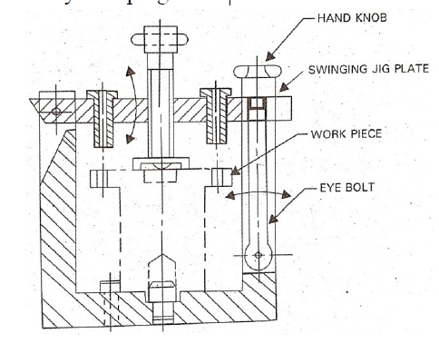
4. Box jig
Used when drilling is required on more than one plane
The body of the jig is made of box like structure in which the component is located
One side of the box would be fitted with cam or latch to provide the necessary opening for inserting the component and unloading it
5. Leaf or latch jig
Drill jig with a hinged jig plate in which one or more drill bushes are fitted
Jig plate must be positively located such that the axes of bushes are vertical during drilling
Latch is clamped by nut and the work piece by clamping screw

Slide 37
6. Indexing jig
Drill jig in which index plate is incorporated so that the work piece can be indexed successively for drilling series of holes on its surface under a single bushing
7. Universal jig
Universal or pump jigs are plate jigs with guide pillars
The guide pillars position the drill bushes correctly with respect to the work piece located on the base plate
The jig plate is lowered to touch and clamp the work piece, and after drilling it is raised to relieve the work piece
The jig plate is moved by handle which operates rack and pinion
Universal jigs are used for drilling work pieces having parallel surfaces

Slide 38
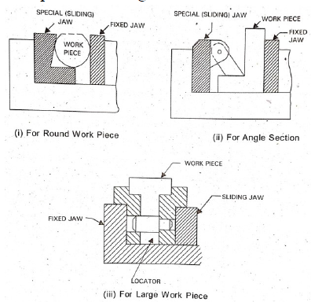
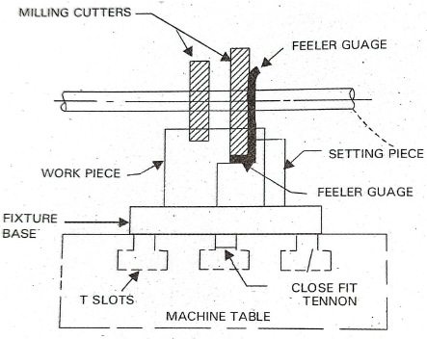
TYPES OF FIXTURES
1. Machine vices
The machine vice is the simplest form of fixtures used to hold the parts for machining
Special jaws are designed to accommodate off shaped work piece and at the same time to prevent damage to machined surfaces
2. Milling fixtures
The cutting force induced in milling is heavy and therefore, the fixture is rigidity attached to the table
Essentially consists of base, tenon strips, setting blocks, T-bolts, clamps and locating pins

Slide 39
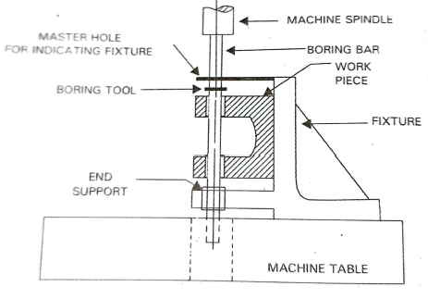
3. Boring fixture
Purpose is to guide the boring bar as in drilling or to hold the work piece in position
Not rigid because cutting force induced is smaller than milling

